Slide 1
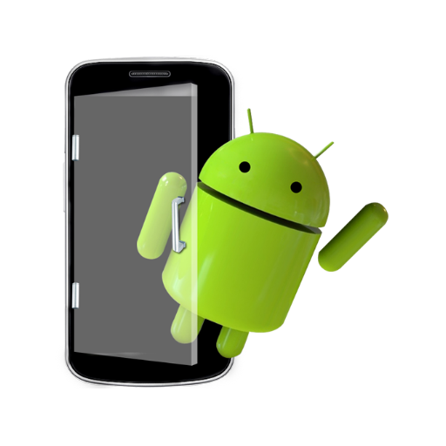

Presentation
on
Mobile Application Development
Submitted by –
Name : Shib Kumar Saraf
Reg. No. : 22352239
MCA 2nd Year(3rd sem)
Pondicherry University
(Karaikal Campus)

Slide 2

Overview of Android Application
QuikChat is a feature-rich Android application designed to provide users with a seamless and interactive messaging experience.
QuikChat is developed using the Kotlin programming language.
The application utilizes XML in conjunction with the Gradle build system for designing user interfaces.
The app allows users to sign up, log in, and communicate with other users in real-time.
QuikChat offers a robust real-time messaging system, allowing users to communicate instantly with each other through text messages. This feature includes: Instant Message Delivery and Message History
Leveraging Firebase for backend integration, QuikChat ensures secure and reliable messaging services.

Slide 3
Application Features
1. User Authentication
Signup: New users can create an account by providing necessary details.
Login: Existing users can securely log in to their accounts.
2. User Interaction: QuikChat enables users to see a list of other registered users.
3. Real-time Messaging
QuikChat offers a robust real-time messaging system(sending and receiving), allowing users to communicate instantly with each other through text messages. This feature includes:
a. Instant Message Delivery: Messages are delivered to the recipient in real-time, providing a quick and responsive communication experience.
b. Message History: The app maintains a comprehensive message history, allowing users to review past conversations seamlessly for every user (both sender and receiver).
4. Logout: Users can securely log out of their accounts.
5. Firebase Integration
Real-time Database: QuikChat utilizes Firebase Realtime Database for storing and retrieving user data and messages.
Authentication: Firebase Authentication ensures secure user authentication.

Slide 4
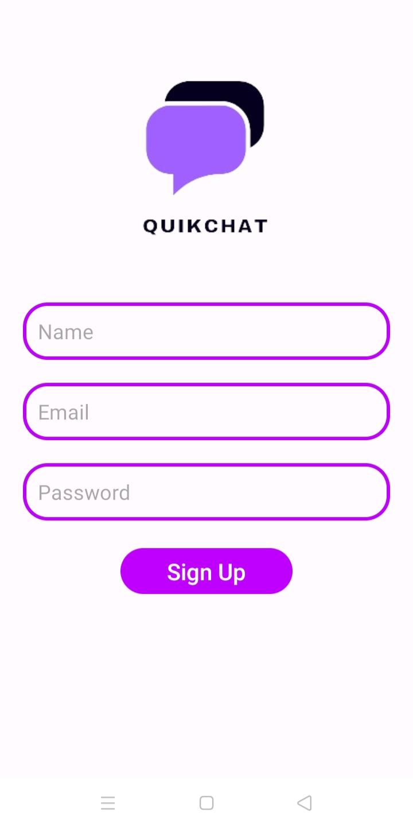
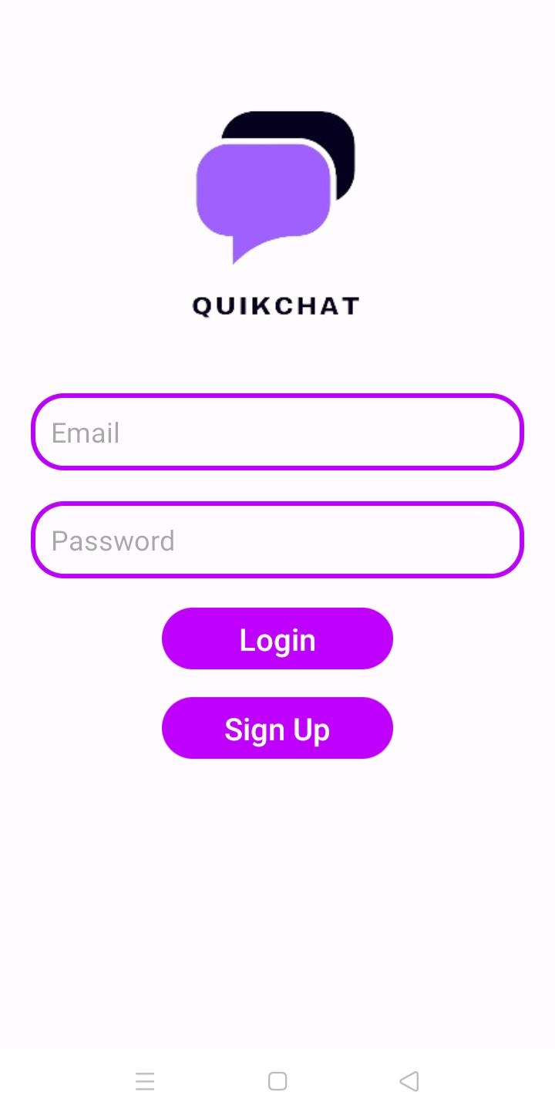
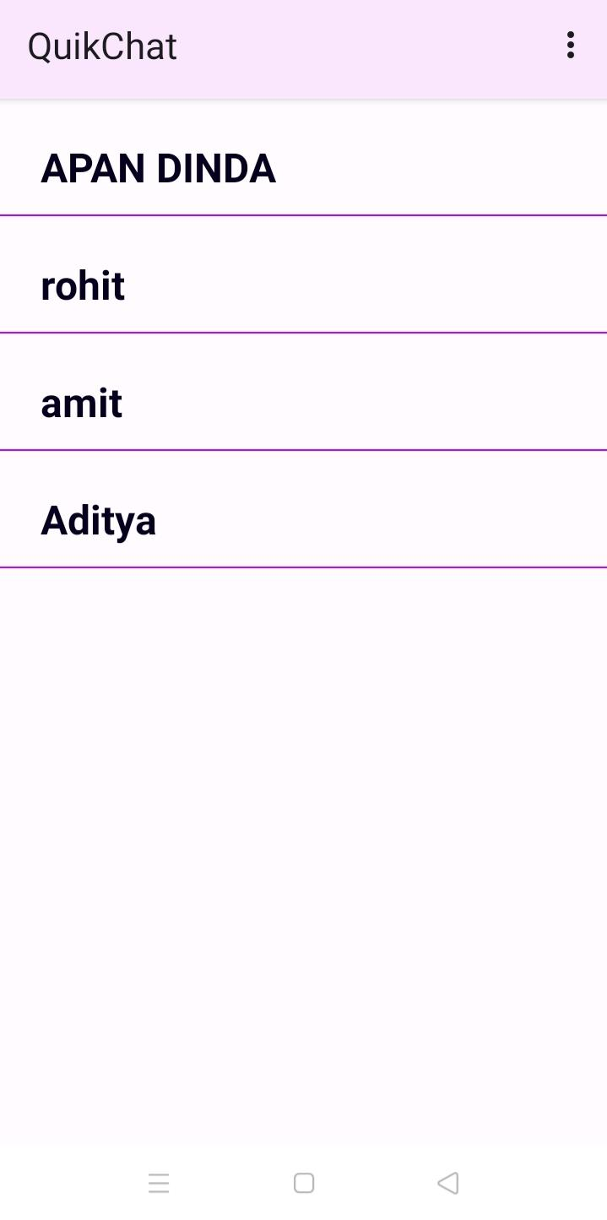
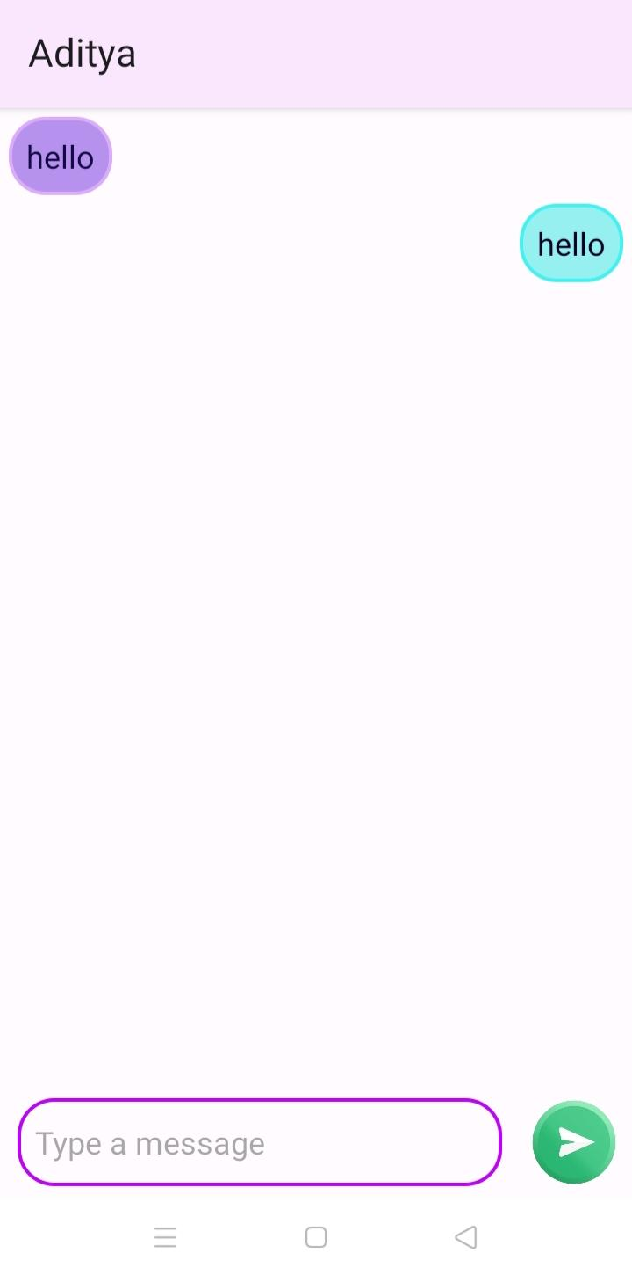
Screenshots
SignUp Page
Index Page or Login Page
Home Page
User Chat

Slide 5
Data Flow Diagram
User Authentication: Login
User Input
User provides email and password
LoginActivity
Firebase Authentication
Authenticate user using provided credentials
Error Mesage
else
If authenticated user
Retrieve user information from Firebase Realtime Database

Slide 6
Data Flow Diagram
User Authentication: SignUp
User Input
User provides name,email and password
SignUpActivity
Firebase Authentication
Create a new user account using provided credentials
Error Message
If user exists
else
Save user information in Firebase Realtime Database

Slide 7
Data Flow Diagram
Showing the user list with tap option to go inside each profile (Home Page)
MainActivity
UserAdapter
On tap on a user name
RecyclerView
(List of Users)
ChatActivity
UserViewHolder
MessageAdapter
Single User UI
Displays user name on top
Single Message UI
Displays message details

Slide 8
Data Flow Diagram
Send Message
User Input
ChatActivity
Push to db
MessageList
Firebase Realtime Database
Retrieving data
MessageAdapter
Single Message UI
Displays message details

Slide 9
Data Flow Diagram
Receiving Message
ChatActivity
MessageList
Firebase Realtime Database
Retrieving data
MessageAdapter
Single Message UI
Displays message details

Slide 10
Data Flow Diagram
Logout
User Input
User initiates logout action
MainActivity
Firebase Authentication
Sign out the current user
Error Mesage
else
If Successful

Slide 11
THANK
YOU …

